Slide 1
YouDescribe
A Free Tool!
Add Audio Description to Any YouTube Video
YouDescribe.org
The Smith-Kettlewell Eye Research Institute, @SKERI_YD
http://bit.ly/CSUN18YD

Slide 2

Joshua A. Miele, Ph.D.
Yue-Ting Siu, Ph.D.
The Smith-Kettlewell Eye Research Institute
jam@ski.org
twitter: @BerkeleyBlink
San Francisco State University
ysiu@sfsu.edu
twitter: @TVI_ting

Slide 3
What is audio description?
Audio description:
An extra audio track added by a describer that lets a visually impaired person know what is happening on screen.
Often-missed visual information:
Text on screen
Setting
Anything not visualized by audio cues
Sight-gags
Tables, charts, and measurements

Slide 4
What is so important about description?
Accessibility to:
Education
Work
Social networks

Slide 5
What is YouDescribe?
Free Web based application
Record description to any YouTube video
No special equipment needed! Use internet with any computer and microphone
Has a variety of great features
Supported by how-to videos, dedicated support and FAQ page, plus specific help by email

Slide 6
Who benefits from audio description?
Anyone with difficulty accessing videos visually:
Blind or low vision consumers including students
Seated too far from the screen or stage
Anyone who needs scaffolding due to language or cognitive diversity
English Language Learners
Support with inferential thinking?

Slide 7
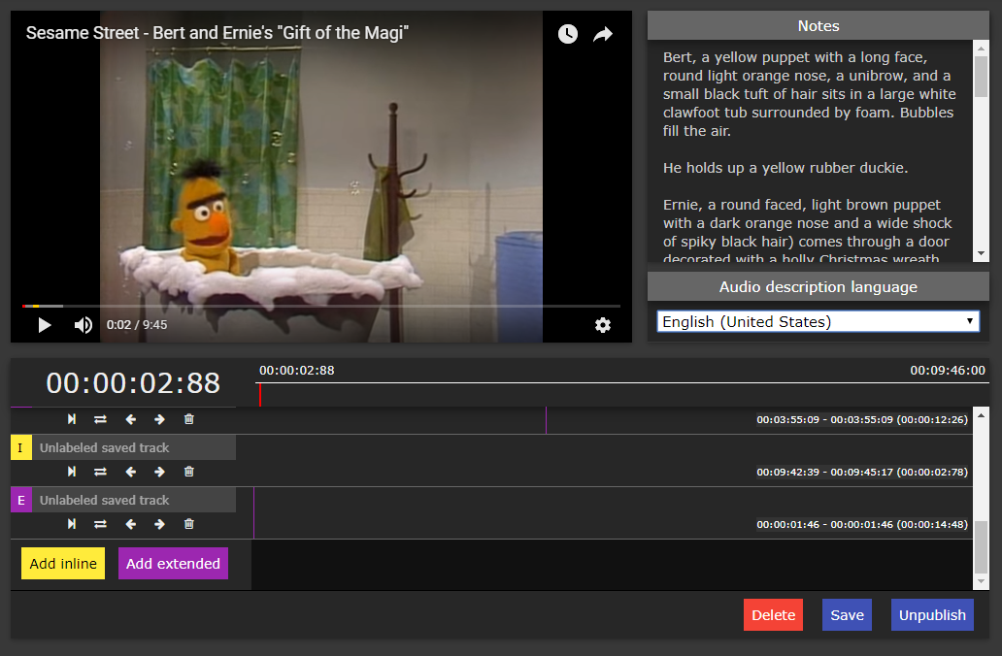
Unique features of YouDescribe
Inline vs. Extended
Inline Description: Ducks main audio, plays description while video plays
Extended Description: Pauses video for description, resumes when description is done
Nudge Feature
Moves audio track 0.15 seconds earlier or later.

Slide 8
What about copyright?
Adding audio description with YouDescribe is fair use…
YouTube videos are not copied, redistributed or modified
Audio description clips and meta data are stored on the YouDescribe server
Described videos stream straight from YouTube and synch descriptions in the browser
YouDescribe complies with YouTube terms of use

Slide 9
Audio Description Quality

Slide 10

Professional Description
YouDescribe

Slide 11
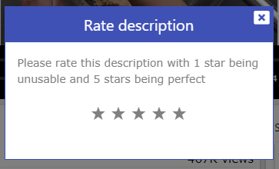
YouDescribe Rating System
Users can rate described videos one to five stars

Slide 12
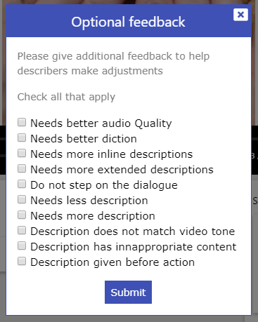
YouDescribe Feedback System
Select from pre-set of suggestions to improve description quality.

Slide 13
Describer Communities

Slide 14
Who uses YouDescribe?
Teachers
Other
Professionals
Friends and Family
All Educational Settings
k-12
College
Education Teams
Parents
Gen. Ed & SPED staff
Teachers of the visually impaired
Foreign language
Social description has enormous cultural value
Different from work and school style description
Fun, relaxed, informal
Rapid delivery of high-quality description product
Lower cost option for museums, libraries, nonprofit and for-profit agencies.

Slide 15
Describe-a-thon
A day of description
Volunteer describers contribute as many audio descriptions as they can in a single day
Periodic event with changing themes and target communities
#Describeathon17, #Describeathon18

Slide 16
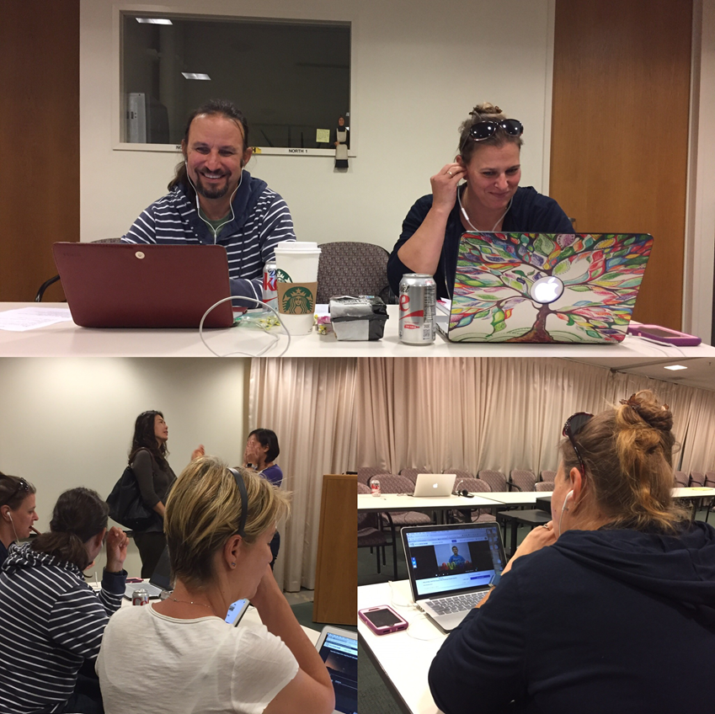
Description workshops
In-person and online events
Teacher prep (SFSU, Perkins)
Professional development
Teach basics of audio description and YouDescribe
TVIs creating audio descriptions at YouDescribe Science! One of our many outreach events.

Slide 17
Teaching composition and language skills with YouDescribe
Audio Description is great for teaching writing skills.
Professors assign YouDescribe projects to teach writing and disability studies.
Georgina Kleege, UC Berkeley
Julia Rodas, CUNY
Eva Schaeffer-Lacroix, Sorbonne

Slide 18
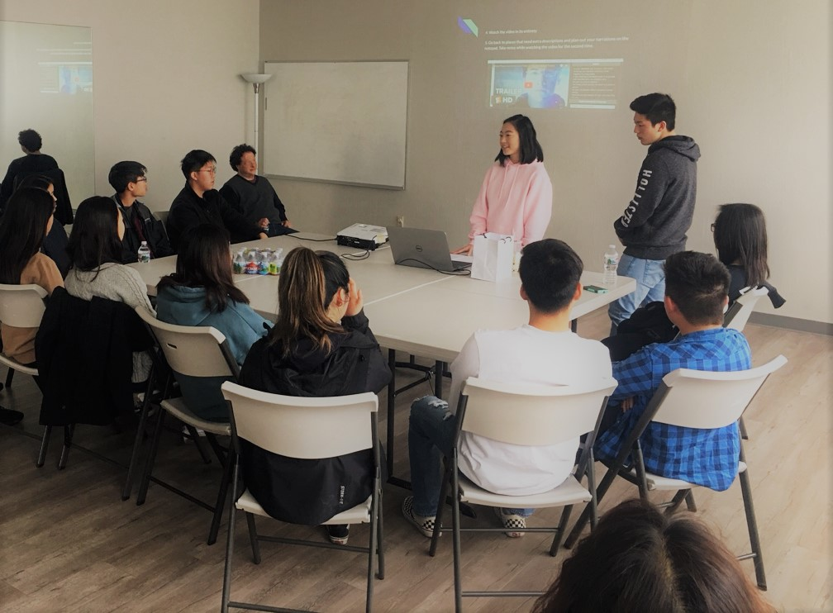
High School Volunteer Describer Club
Korean-American High School students from Pleasanton meet their community service requirements by contributing to YouDescribe.
Korean Parents Association http://www.trivalleykpa.org/kpa/english/

Slide 19
YouDescribe help and support
General information about YouDescribe
FAQ pages for viewers
FAQ for describers
Step-by-step audio description tutorial
Troubleshooting section
Video Tutorials
Audio Description Basics for Beginners
What is YouDescribe? A video tutorial

Slide 20
YouDescribe Tech Community

Slide 21

San Francisco State University
Project-based learning for 6 CS masters students in 2017-18 using YouDescribe and the YouDescribe API.
Cloud-based computing
Web-based multimedia
Accessibility!

Slide 22
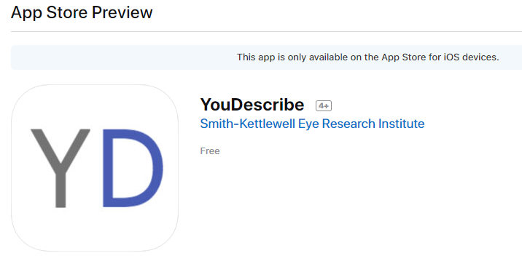
YouDescribe iOS app in beta testing
Developed by Rupal Khilari, at San Francisco State University with guidance from Professor Ilmi Yoon, Ph.D

Slide 23


Codesmith
In spring 2017, 3 enterprising Codesmith students rebuilt YouDescribe from the ground up!
Modern web framework
HTML5 video player
Description rating and feedback system
Google authentication

Slide 24
Interested in helping out?
There's always more to do. Would you like to contribute to the YouDescribe codebase?
Server Side -- notifying describers of views and ratings
Authoring Tools -- Improving the usability and features for creating descriptions
Plugins and Applets -- extending YouDescribe functionality onto other websites
JOIN US!

Slide 25
YouDescribe Timeline at a glance
March 2013 YouDescribe created
First
Describe-a-thon
GAAD 2014
FCC's 2014 Award for Advancement in Accessibility
2017 YouDescribe Relaunched
2018
iOS app in beta testing
Latest
Describe-a-thon April 21st
125 TVI’s trained in 2017
In 2016 YD supported by CA Access Foundation

Slide 26
YouDescribe Current Statistics
1,710 Registered YouDescribe accounts
133 Wish List Videos
89% of videos rated
very good or excellent
1,915 Described Videos

Slide 27

http://bit.ly/CSUN18YD
YouDescribe https://youdescribe.org/
FB community of Practice https://www.facebook.com/youdescribe/
Smith-Kettlewell https://www.ski.org/
Twitter @SKERI_YD
Twitter: @BerkeleyBlink
Twitter: @TVI_ting

